Slide 1
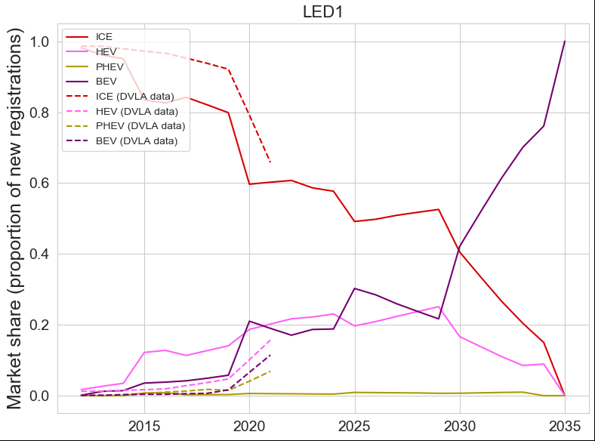
The Recalibration of STEVE
Baseline (no changes) but LED1 cost tables

Slide 2
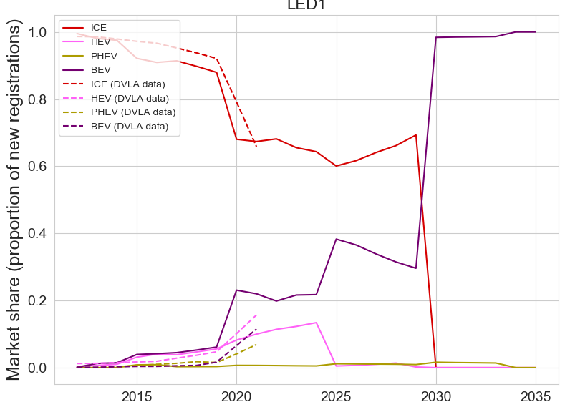
The Recalibration of STEVE
SP of ICE reduced; SP of HEV increased
Next:
Reduce BEV supply penalty from 2026
Increase awareness of EVs by 20%, shift along by 5 yrs

Slide 3
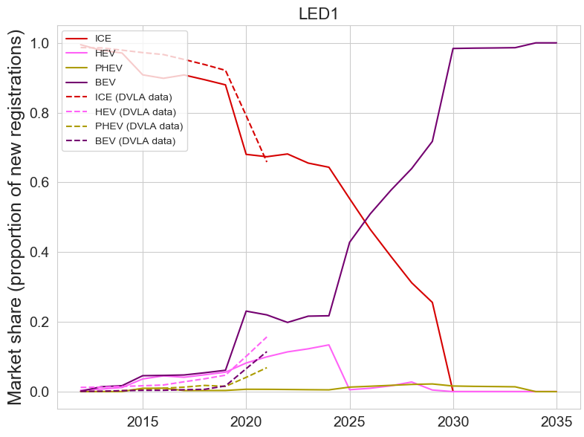
The Recalibration of STEVE
Next:
Reduce SP for PHEV

Slide 4
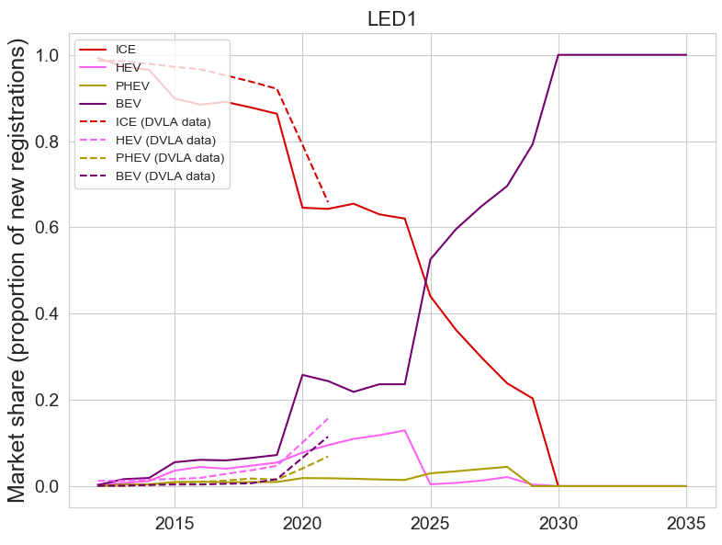
The Recalibration of STEVE
Next:
Increase SP for BEV
Further reduce SP for PHEV

Slide 5
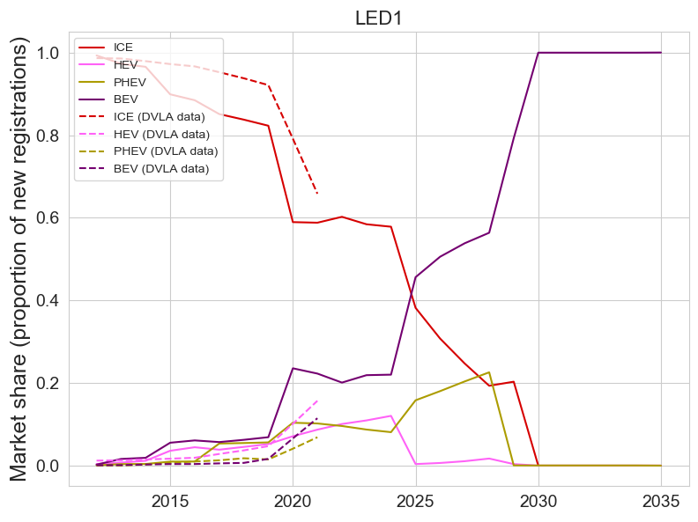
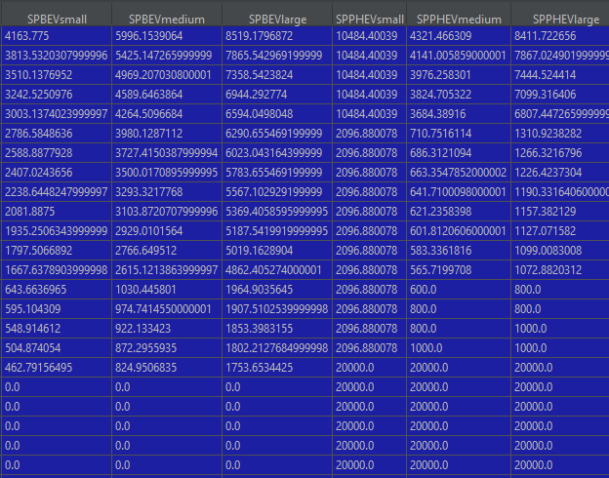
Next
Increase SP of PHEV
Increase SP of BEV
PHEVs still v expensive 2030-35
Added another toggle date y3

Slide 6
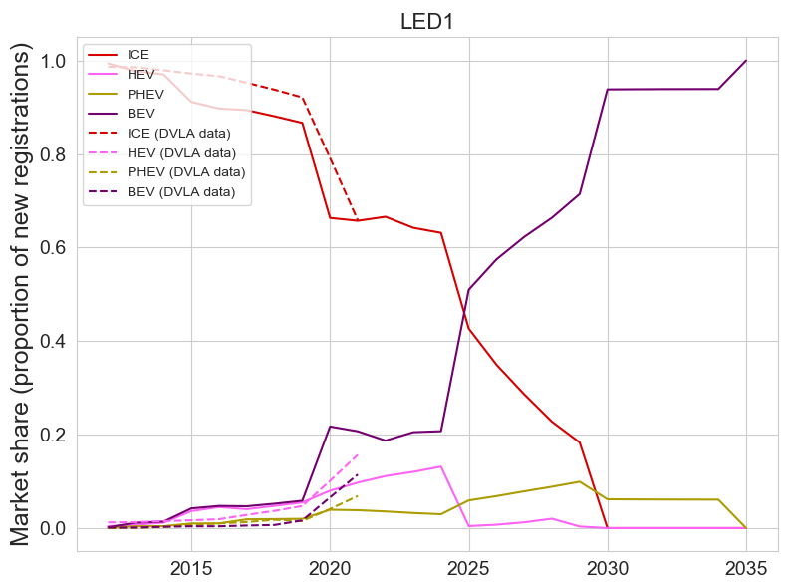
Lower SP for PHEV and HEV

Slide 7
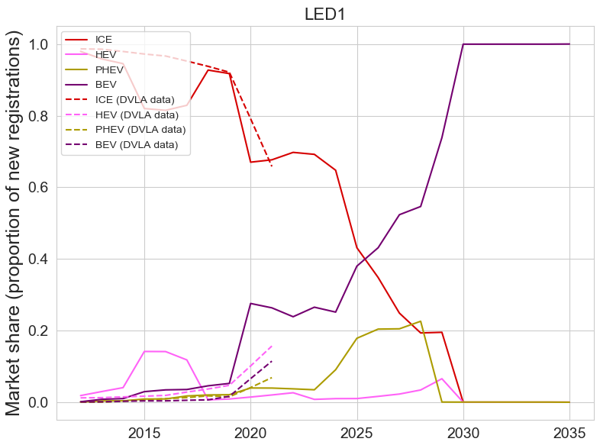
Introduced more levers
This is quite slow
See if the dictionary idea has legs
It does not, there is so much data tied up in tables, e.g. CostData, Technology, …
Would have to convert all them to dicts
It really isn’t v workable

Slide 8
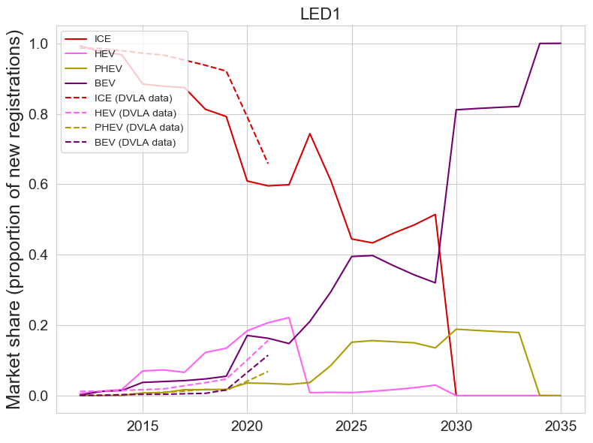
Levers pulled
Next:
Increase HEV SP

Slide 9
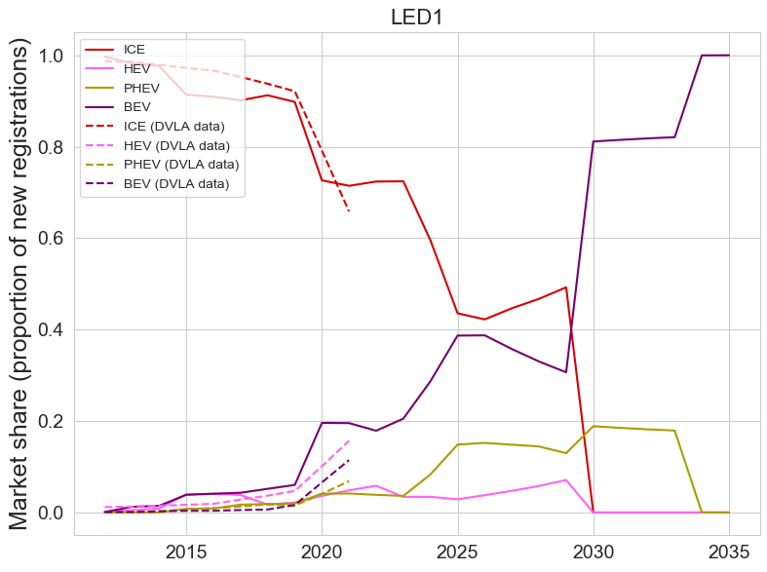
Reduce HEV SP

Slide 10
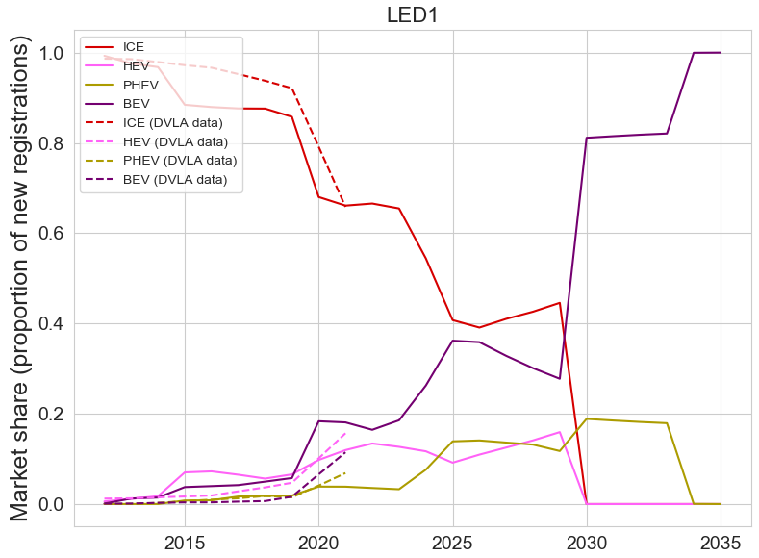
Getting close. Reduce BEV SP after 2026 (y=14)
Try using negative multipliers

Slide 11
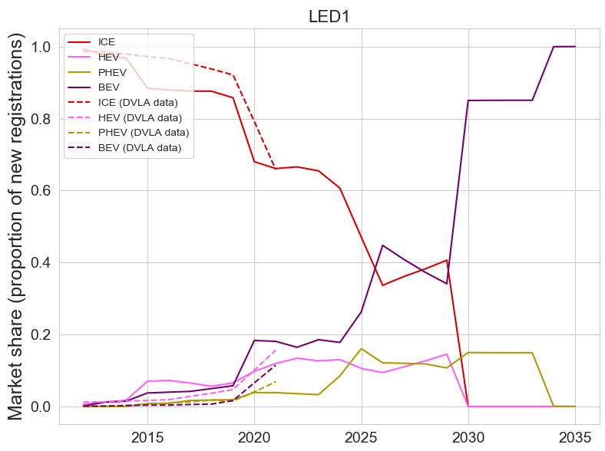
Increase ICE SP after 2026 (y=14

Slide 12
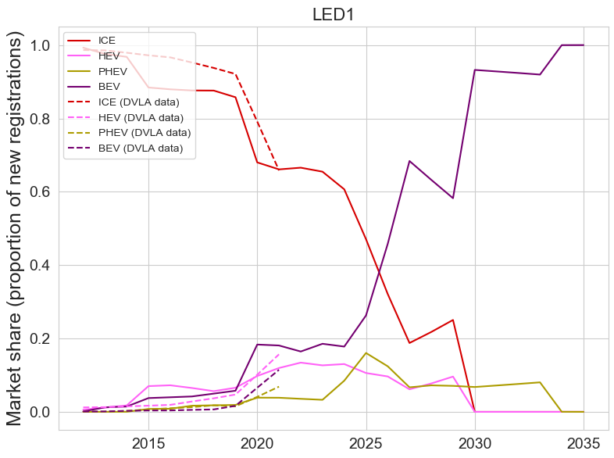

Slide 13
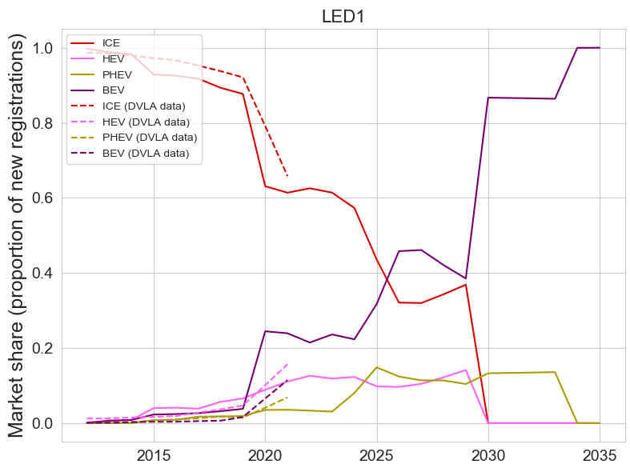
Increase BEV SP

Slide 14
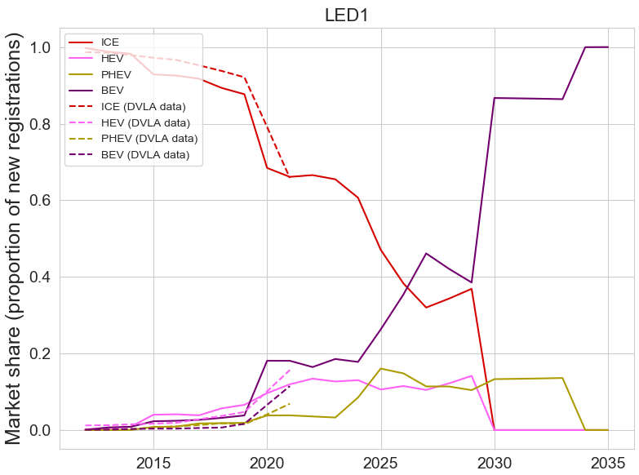
Why is there that fucking dip
Its 2028 and 2029

Slide 15
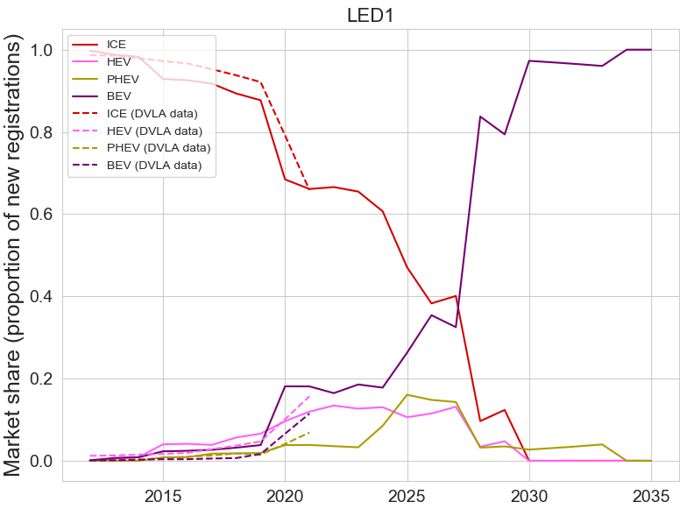
Best yet
Increase SP for BEVs before 2021
Reduce SP for PHEVs 2021-2024

Slide 16
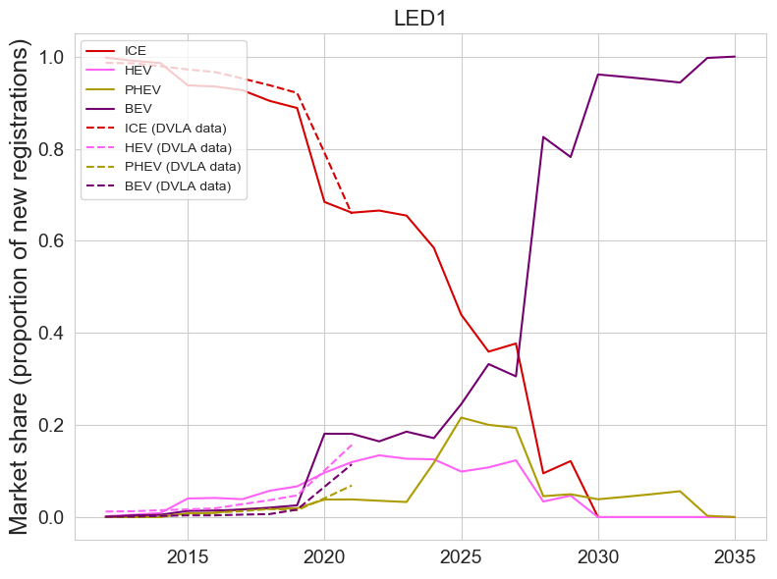
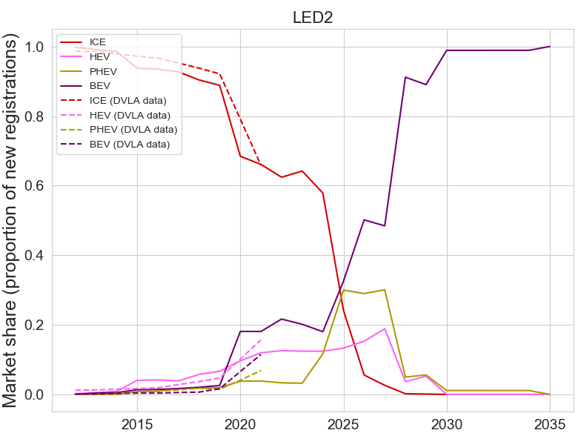

Slide 17
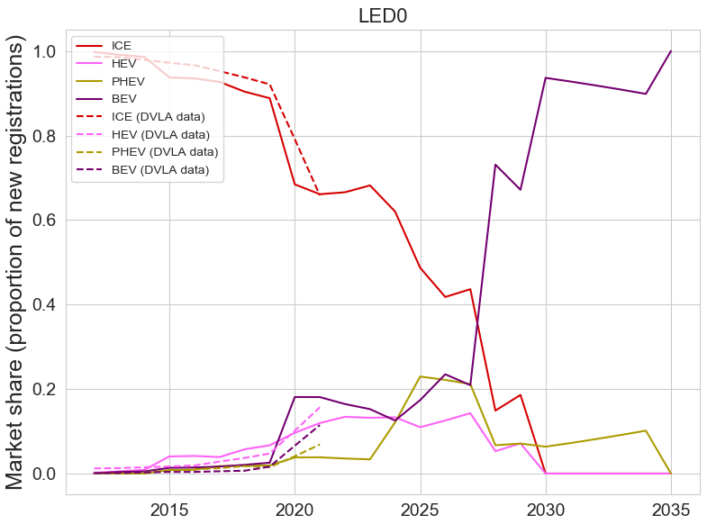
Now compare with other LED scenarios

Slide 18
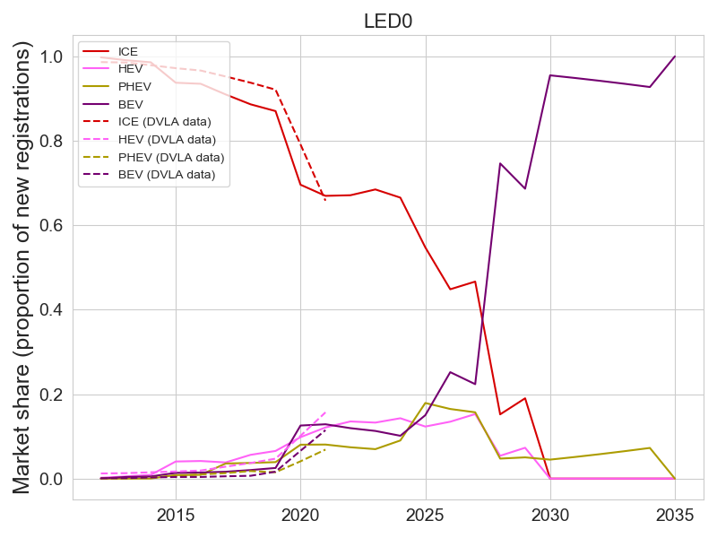
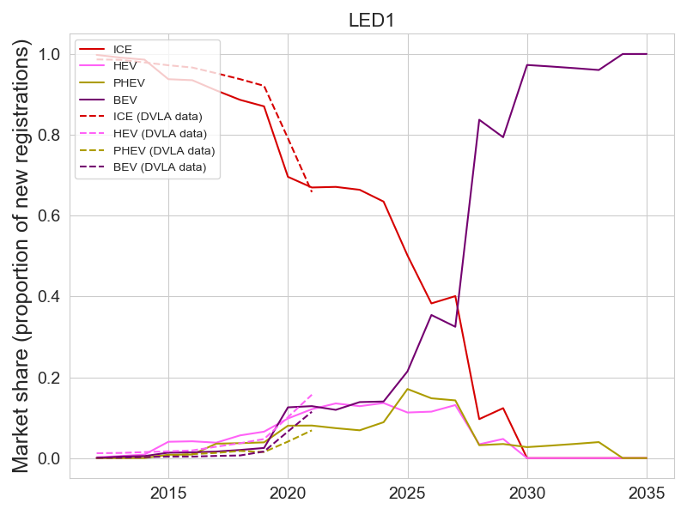
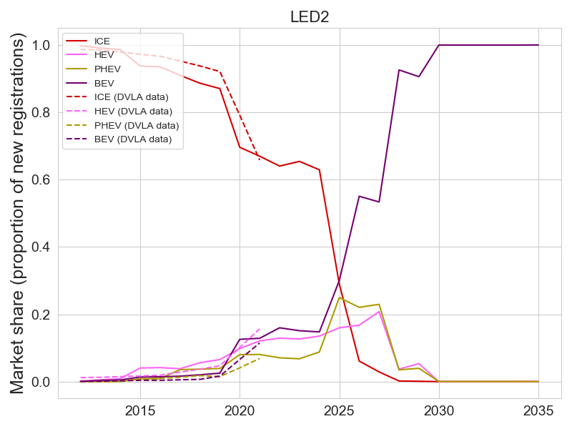
That’ll do pig

